Slide 1
Cloud Infrastructure Management

Slide 2
Introduction
  Infrastructure-as-a-Service (IaaS)
  Platform-as-a-Service (PaaS)
  Software-as-a-Service (SaaS)
Amazon is a pioneer in IaaS, Google’s efforts are focused on SaaS and PaaS delivery models, and Microsoft is involved in PaaS
Private clouds are an alternative to public clouds. Open-source cloud computing platforms such as Eucalyptus , OpenNebula, Nimbus, and OpenStack can be used as a control infrastructure for a private cloud
Our discussion of the cloud infrastructure with an overview of service level agreements (SLAs) and the responsibility sharing between users and cloud service providers, followed by a brief discussion of software licensing, energy consumption, and ecological impact of cloud computing. We conclude with a section covering user experiences with current systems

Slide 3
Cloud computing at Amazon
In mid-2000 Amazon introduced Amazon Web Services (AWS), based on the IaaS delivery model. In this model the cloud service provider offers an infrastructure consisting of compute and storage servers interconnected by high-speed networks that support a set of services to access these resources.
An application developer is responsible for installing applications on a platform of his or her choice and managing the resources provided by Amazon
Amazon was the first provider of cloud computing; it announced a limited public beta release of its Elastic Computing platform called EC2 in August 2006.

Slide 4
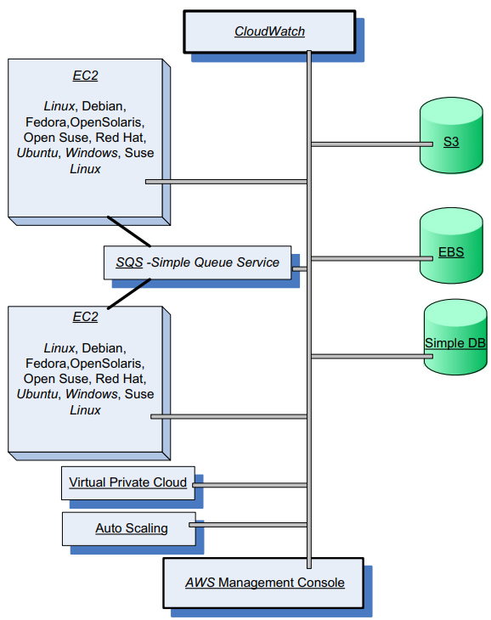
Cloud computing at Amazon
Figure 3.1 shows the palette of AWS services accessible via the Management Console

Slide 5
Cloud computing at Amazon
Elastic Compute Cloud (EC2) is a Web service with a simple interface for launching instances of an application under several operating systems, such as several Linux distributions, Microsoft Windows Server 2003 and 2008, OpenSolaris, FreeBSD, and NetBSD
An instance is created either from a predefined Amazon Machine Image (AMI) digitally signed and stored in S3 or from a user-defined image.
The image includes the operating system, the run-time environment, the libraries, and the application desired by the user. AMI images create an exact copy of the original image but without configuration-dependent information such as the hostname or the MAC address.
A user can:
(i) Launch an instance from an existing AMI and terminate an instance;
(ii) start and stop an instance;
(iii) create a new image;
(iv) add tags to identify an image; and
(v) reboot an instance.

Slide 6
Cloud computing at Amazon
A user can interact with EC2 using a set of SOAP messages and can list available AMI images, boot an instance from an image, terminate an image, display the running instances of a user, display console output, and so on.
The user has root access to each instance in the elastic and secure computing environment of EC2. The instances can be placed in multiple locations in different regions and availability zones.
EC2 allows the import of virtual machine images from the user environment to an instance through a facility called VM import. It also automatically distributes the incoming application traffic among multiple instances using the elastic load-balancing facility.
EC2 associates an elastic IP address with an account; this mechanism allows a user to mask the failure of an instance and remap a public IP address to any instance of the account without the need to interact with the software support team.

Slide 7
Cloud computing at Amazon
Simple Storage System (S3) is a storage service designed to store large objects. It supports a minimal set of functions: write, read, and delete.
S3 allows an application to handle an unlimited number of objects ranging in size from one byte to five terabytes.
An object is stored in a bucket and retrieved via a unique developer-assigned key. A bucket can be stored in a region selected by the user.
S3 maintains the name, modification time, an access control list, and up to four kilobytes of user-defined metadata for each object.
The object name are global. Authentication mechanisms ensure that data is kept secure; objects can be made public, and rights can be granted to other users.
S3 supports PUT, GET, and DELETE primitives to manipulate objects but does not support primitives to copy, rename, or move an object from one bucket to another. Appending to an object requires a read followed by a write of the entire object
The Amazon S3 SLA guarantees reliability. S3 uses standards-based REST and SOAP interfaces; the default download protocol is HTTP

Slide 8
Cloud computing at Amazon
Elastic Block Store (EBS) provides persistent block-level storage volumes for use with Amazon EC2 instances.
A volume appears to an application as a raw, unformatted, and reliable physical disk; the size of the storage volumes ranges from one gigabyte to one terabyte.
The volumes are grouped together in availability zones and are automatically replicated in each zone.
An EC2 instance may mount multiple volumes, but a volume cannot be shared among multiple instances.
The EBS supports the creation of snapshots of the volumes attached to an instance and then uses them to restart an instance.
The storage strategy provided by EBS is suitable for database applications, file systems, and applications using raw data devices

Slide 9
Cloud computing at Amazon
Simple DB is a nonrelational data store that allows developers to store and query data items via Web services requests. Simple DB creates multiple geographically distributed copies of each data item and supports high-performance Web applications; at the same time, it automatically manages infrastructure provisioning, hardware and software maintenance, replication and indexing of data items, and performance tuning
Simple Queue Service (SQS) is a hosted message queue. SQS is a system for supporting automated workflows; it allows multiple Amazon EC2 instances to coordinate their activities by sending and receiving SQS messages. Developers can access SQS through standards-based SOAP and Query interfaces. Queues can be shared with other AWS accounts and anonymously; queue sharing can also be restricted by IP address and time-of-day
CloudWatch is a monitoring infrastructure used by application developers, users, and system administrators to collect and track metrics important for optimizing the performance of applications and for increasing the efficiency of resource utilization

Slide 10
Cloud computing at Amazon
Virtual Private Cloud (VPC) provides a bridge between the existing IT infrastructure of an organization and the AWS cloud. The existing infrastructure is connected via a virtual private network (VPN) to a set of isolated AWS compute resources. VPC allows existing management capabilities such as security services, firewalls, and intrusion detection systems to operate seamlessly within the cloud.
Auto Scaling exploits cloud elasticity and provides automatic scaling of EC2 instances. The service supports grouping of instances, monitoring of the instances in a group, and defining triggers and pairs of CloudWatch alarms and policies, which allow the size of the group to be scaled up or down. Typically, a maximum, a minimum, and a regular size for the group are specified.

Slide 11
Cloud computing at Amazon
Elastic Beanstalk, a service that interacts with other AWS services, including EC2, S3, SNS, Elastic Load Balance, and Auto Scaling, automatically handles the deployment, capacity provisioning, load balancing, Auto Scaling, and application monitoring functions.
The service automatically scales the resources as required by the application, either up, or down based on default Auto Scaling settings.
Some of the management functions provided by the service are:
(i) deployment of a new application version (or rollback to a previous version);
(ii) access to the results reported by CloudWatch monitoring service;
(iii) email notifications when application status changes or application servers are added or
removed; and
(iv) access to server login files without needing to login to the application servers.

Slide 12
Cloud computing:GOOGLE PERSPECTIVE
Google’s effort is concentrated in the area of Software-as-a-Service (SaaS). Services such as Gmail, Google Drive, Google Calendar, Picasa, and Google Groups are free of charge for individual users and available for a fee for organizations. These services are running on a cloud and the data for these services is stored in data centers on the cloud.
The Gmail service hosts emails on Google servers and, provides a Web interface to access them. Google Docs is Web-based software for building text documents, spreadsheets, and presentations.
Google Calendar is a browser-based scheduler; it supports multiple calendars for a user, the ability to share a calendar with other users, the display of daily/weekly/monthly views, and the ability to search events. Event reminders can be received via SMS, desktop popups, or emails
Picasa is a tool to upload, share, and edit images; it provides 1 GB of disk space per user free of charge. Users can add tags to images and attach locations to photos using Google Maps. Google Groups allows users to host discussion forums to create messages online or via email

Slide 13
Cloud computing:GOOGLE PERSPECTIVE
Google is also a leader in the Platform-as-a-Service (PaaS) space. AppEngine is a developer platform hosted on the cloud. Initially it supported only Python, but support for Java was added later. The database for code development can be accessed with Google Query Language (GQL) with a SQL-like syntax
Google Base is a service allowing users to load structured data from different sources to a central repository that is a very large, self-describing, semi-structured, heterogeneous database. It is self describing because each item follows a simple schema: (item type, attribute names).
Google Drive is an online service for data storage that has been available since April 2012. It gives users 5 GB of free storage and charges $4 per month for 20 GB
Google has also redefined the laptop with the introduction of the Chromebook, a purely Web-centric device running Chrome OS. Cloud-based applications, extreme portability, built-in 3G connectivity, almost instant-on, and all-day battery life are the main attractions of this device with a keyboard

Slide 14
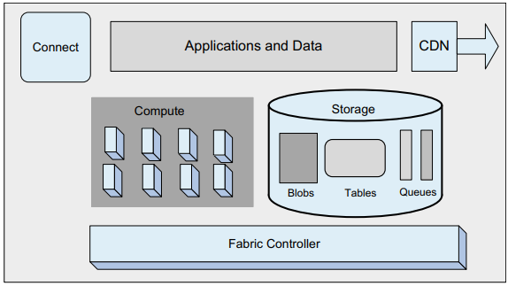
Cloud computing: AZURE and ONLINE SERVICES
Azure and Online Services are, respectively, PaaS and SaaS cloud platforms from Microsoft. Windows Azure is an operating system, SQL Azure is a cloud-based version of the SQL Server, and Azure AppFabric (formerly .NET Services) is a collection of services for cloud applications.
Windows Azure has three core components

Slide 15
Cloud computing: AZURE and ONLINE SERVICES
Compute, which provides a computation environment; Storage for scalable storage; and Fabric Controller, which deploys, manages, and monitors applications; it interconnects nodes consisting of servers, high-speed connections, and switches
The Content Delivery Network (CDN) maintains cache copies of data to speed up computations. The Connect subsystem supports IP connections between the users and their applications running on Windows Azure. The API interface to Windows Azure is built on REST, HTTP, and XML
The computations carried out by an application are implemented as one or more roles; an application typically runs multiple instances of a role. We can distinguish
(i) Web role instances used to create Web applications;
(ii) Worker role instances used to run Windows-based code; and
(iii) VM role instances that run a user-provided Windows Server 2008 R2 image

Slide 16
Cloud computing: AZURE and ONLINE SERVICES
Scaling, load balancing, memory management, and reliability are ensured by a fabric controller. The fabric controller decides where new applications should run; it chooses the physical servers to optimize utilization using configuration information uploaded with each Windows Azure application.
The configuration information is an XML-based description of how many Web role instances, how many Worker role instances, and what other resources the application needs. The fabric controller uses this configuration file to determine how many VMs to create.
Blobs, tables, queues, and drives are used as scalable storage. A blob contains binary data; a container consists of one or more blobs. Blobs can be up to a terabyte and they may have associated metadata (e.g., the information about where a JPEG photograph was taken).
The Microsoft Azure platform currently does not provide or support any distributed parallel computing frameworks, such as MapReduce, Dryad, or MPI, other than the support for implementing basic queue-based job scheduling

Slide 17
Open-source software platforms for private clouds
Open source cloud computing platforms such as Eucalyptus, OpenNebula, and Nimbus can be used as a control infrastructure for a private cloud.
Schematically, a cloud infrastructure carries out the following steps to run an application:
• Retrieves the user input from the front end.
• Retrieves the disk image of a VM from a repository.
• Locates a system and requests the VMM running on that system to set up a VM
  • Invokes the DHCP7 and the IP bridging software to set up a MAC and IP address for the VM.

Slide 18
Open-source software platforms for private clouds
Eucalyptus supports several operating systems including CentOS 5 and 6, RHEL 5 and 6, Ubuntu 10.04 LTS, and 12.04 LTS.
The components of the system are:
• Virtual machine. Runs under several VMMs, including Xen, KVM, and Vmware.
• Node controller. Runs on every server or node designated to host a VM and controls the activities of the node. Reports to a cluster controller.
• Cluster controller. Controls a number of servers. Interacts with the node controller on each server to schedule requests on that node. Cluster controllers are managed by the cloud controller.
• Cloud controller. Provides the cloud access to end users, developers, and administrators. It is accessible through command-line tools compatible withEC2 and through a Web-based Dashboard. Manages cloud resources, makes high-level scheduling decisions, and interacts with cluster controllers.

Slide 19
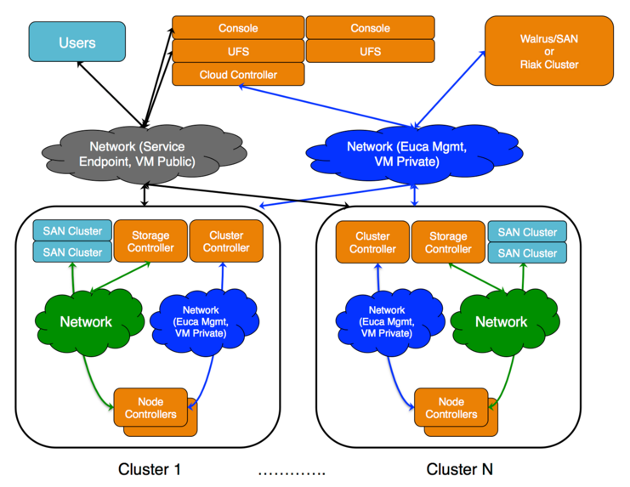

Slide 20
Open-source software platforms for private clouds
• Storage controller. Provides persistent virtual hard drives to applications. It is the correspondent of EBS. Users can create snapshots from EBS volumes. Snapshots are stored in Walrus and made available across availability zones.
• Storage service (Walrus). Provides persistent storage and, similarly to S3, allows users to store objects in buckets.
The system supports a strong separation between the user space and the administrator space; users access the system via a Web interface, whereas administrators need root access.
The system supports a decentralized resource management of multiple clusters with multiple cluster controllers, but a single head node for handling user interfaces. It implements a distributed storage system.

Slide 21
Open-source software platforms for private clouds
The procedure to construct a virtual machine:
• The eucatools front end is used to request a VM.
• The VM disk image is transferred to a compute node.
• This disk image is modified for use by the VMM on the compute node.
• The compute node sets up network bridging to provide a virtual network interface controller (NIC) with a virtual Media Access Control (MAC) address.
• In the head node the DHCP is set up with the MAC/IP pair.
• VMM activates the VM.
• The user can now ssh directly into the VM.

Slide 22
Open-source software platforms for private clouds
Open-Nebula is a private cloud with users actually logging into the head node to access cloud functions.
The system is centralized and its default configuration uses NFS (Network File System).
The procedure to construct a virtual machine consists of several steps:
(i) the user signs into the head node using ssh;
(ii) the system uses the onevm command to request a VM;
(iii) the VM template disk image is transformed to fit the correct size and configuration within the NFS directory on the head node;
(iv) the oned daemon on the head node uses ssh to log into a compute node;
(v) the compute node sets up network bridging to provide a virtual NIC with a virtual MAC;
(vi) the files needed by the VMM are transferred to the compute node via the NFS;
(vii) the VMM on the compute node starts the VM; and
(viii) the user is able to ssh directly to the VM on the compute node

Slide 23
Open-source software platforms for private clouds
Nimbus is a cloud solution for scientific applications based on the Globus software.
The system inherits from Globus the image storage, the credentials for user authentication, and the requirement that a running Nimbus process can ssh into all compute nodes.
Customization in this system can only be done by the system administrators

Slide 24
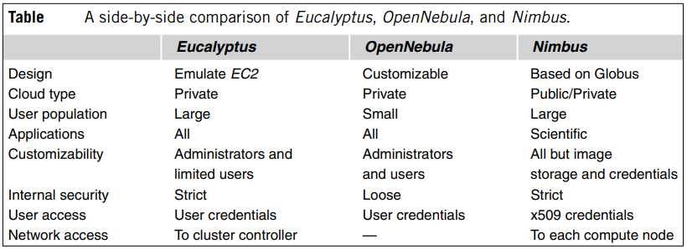
Open-source software platforms for private clouds
Table summarizes the features of the three systems.
The conclusions of the comparative analysis are as follows: Eucalyptus is best suited for a large corporation with its own private cloud because it ensures a degree of protection from user malice and mistakes.
OpenNebula is best suited for a testing environment with a few servers.
Nimbus is more adequate for a scientific community less interested in the technical internals of the system than with broad customization requirements

Slide 25
Cloud storage diversity and vendor lock-in
There are several risks involved when a large organization relies solely on a single cloud provider. Cloud services may be unavailable for a short or even an extended period of time. Such an interruption of service is likely to negatively impact the organization. The potential for permanent data loss in case of a catastrophic system failure poses an equally great danger .
Last but not least, a Cloud Service Provider (CSP) may decide to increase the prices for service and charge more for computing cycles, memory, storage space, and network bandwidth than other CSPs. The alternative in this case is switching to another provider. Unfortunately, this solution could be very costly due to the large volume of data to be transferred from the old to the new provider.
Reliability is a major concern, and here we discuss a solution that addresses both avoidance of vendor lock-in and storage reliability.

Slide 26
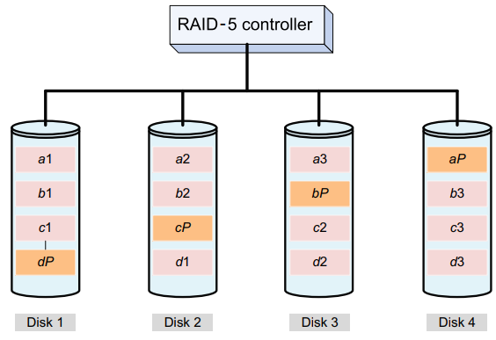
Cloud storage diversity and vendor lock-in
A solution to guarding against the problems posed by the vendor lock-in is to replicate the data to multiple cloud service providers. Straightforward replication is very costly and, at the same time, poses technical challenges.
Another solution could be based on an extension of the design principle of a RAID-5 system used for reliable data storage.
A RAID-5 system uses block-level stripping with distributed parity over a disk array, as shown in Figure

Slide 27
Cloud storage diversity and vendor lock-in
The disk controller distributes the sequential blocks of data to the physical disks and computes a parity block by bit-wise XOR-ing of the data blocks.
The parity block is written on a different disk for each file to avoid the bottleneck possible when all parity blocks are written to a dedicated disk, as is done in the case of RAID-4 systems.
This technique allows us to recover the data after a single disk loss.
For example, if Disk 2 in Figure is lost, we still have all the blocks of the third file, c1, c2, and c3, and we can recover the missing blocks for the others as follows:
  a2 = (a1) XOR (aP) XOR (a3)
  b2 = (b1) XOR (bP) XOR (b3)
  d1 = (dP) XOR (d2) XOR (d3)

Slide 28
Service- level agreements
A service-level agreement (SLA) is a negotiated contract between two parties, the customer and the service provider. The agreement specifies the services that the customer receive rather than how the service provider delivers the services.
The objectives of the agreement are:
• Identify and define customers’ needs and constraints, including the level of resources, security, timing, and quality of service.
• Provide a framework for understanding. A critical aspect of this framework is a clear definition of classes of service and costs.
• Simplify complex issues; for example, clarify the boundaries between the responsibilities of the clients and those of the provider of service in case of failures.
• Reduce areas of conflict.
• Encourage dialogue in the event of disputes.
• Eliminate unrealistic expectations.

Slide 29
Service- level agreements
An SLA records a common understanding in several areas:
(i) services,
(ii) priorities,
(iii) responsibilities,
(iv) guarantees, and
(v) warranties.
An agreement usually covers: services to be delivered, performance, tracking and reporting, problem management, legal compliance and resolution of disputes, customer duties and responsibilities, security, handling of confidential information, and termination.
The common metrics specified by an SLA are service-specific. For example, the metrics used by a call center usually are: (i) abandonment rate: percentage of calls abandoned while waiting to be answered; (ii) average speed to answer: average time before the service desk answers a call; (iii) time service factor: percentage of calls answered within a definite time frame; (iv) first-call resolution: percentage of incoming calls that can be resolved without a callback; and (v) turnaround time: time to complete a certain task

Slide 30
Service- level agreements
The common metrics specified by an SLA are service-specific.
For example, the metrics used by a call center usually are:
(i) abandonment rate: percentage of calls abandoned while waiting to be answered;
(ii) average speed to answer: average time before the service desk answers a call;
(iii) time service factor: percentage of calls answered within a definite time frame;
(iv) first-call resolution: percentage of incoming calls that can be resolved without a callback; and
(v) turnaround time: time to complete a certain task

Slide 31
User experience
The main user concerns are security threats, the dependence on fast Internet connections that forced version updates, data ownership, and user behavior monitoring. All users reported that trust in the cloud services is important.
The security threats perceived by this group of users are:
(i) abuse and villainous use of the cloud;
(ii) APIs that are not fully secure;
(iii) malicious insiders;
(iv) account hijacking;
(iv) data leaks; and
(v) issues related to shared resources.
Identity theft and privacy were major concerns for about half of the users questioned; availability, liability, and data ownership and copyright were raised by a third of respondents.

Slide 32
User experience
The suggested solutions to these problems are as follows:
  SLAs and tools to monitor usage should be deployed to prevent abuse of the cloud;
  data encryption and security testing should enhance the API security;
  an independent security layer should be added to prevent threats caused by malicious insiders;
  strong authentication and authorization should be enforced to prevent account hijacking;
  data decryption in a secure environment should be implemented to prevent data leakage; and
  Compart mentalization of components and firewalls should be deployed to limit the negative effect of resource sharing.

Slide 33
User experience
A broad set of concerns identified by the NIST working group on cloud security includes:
• Potential loss of control/ownership of data.
• Data integration, privacy enforcement, data encryption.
• Data remanence after deprovisioning.
• Multitenant data isolation.
• Data location requirements within national borders.
• Hypervisor security.
• Audit data integrity protection.
• Verification of subscriber policies through provider controls.
• Certification/accreditation requirements for a given cloud service

Slide 34
Software Licensing
Software licensing for cloud computing is an enduring problem. The Software-as-a-Service (SaaS) deployment model is gaining acceptance because it allows users to pay only for the services they use.
A commercial product is elasticLM, which provides license and billing for Web-based services. The architecture of the elasticLM license service has several layers: coallocation, authentication, administration, management, business, and persistency.
The authentication layer authenticates communication between the license service and the billing service as well as the individual applications; the persistence layer stores the usage records.
The main responsibility of the business layer is to provide the licensing service with the licenses prices, and the management coordinates various components of the automated billing service.
When a user requests a license from the license service, the terms of the license usage are negotiated and they are part of an SLA document. The SLA describes all aspects of resource usage, including the ID of application, duration, number of processors, and guarantees, such as the maximum cost and deadlines

